Slide 1

Introduction to Heterogeneous Computing Systems

Slide 2
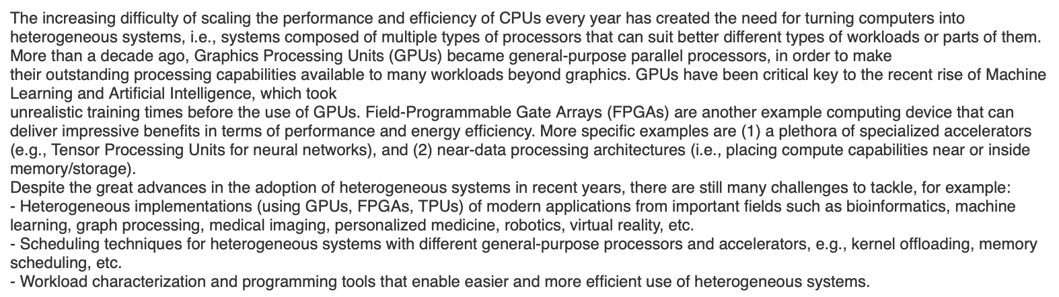
Heterogeneous Systems
http://www.vvz.ethz.ch/Vorlesungsverzeichnis/lerneinheit.view?semkez=2021W&ansicht=KATALOGDATEN&lerneinheitId=154599&lang=en
Notes:
The motivating goal of this course is the difficulty of scaling performance where the energy efficiency of the CPU can affect very important workloads such as machine learning and artificial intelligence and bioinformatics graphics processing. To address these difficulties, we are increasingly using heterogeneous devices, such as GPUS, that will be key to the rise of machine learning and artificial intelligence. The content of this course and how to program and use them, for example neural networks, network gas pedal systems or near-data processing architectures.

Slide 3
Flynn’s Taxonomy of Computers
Mike Flynn, “Very High-Speed Computing Systems,” Proc. of IEEE, 1966
SISD: Single instruction operates on single data element
SIMD: Single instruction operates on multiple data elements
Array processor
Vector processor
MISD: Multiple instructions operate on single data element
Closest form: systolic array processor, streaming processor
MIMD: Multiple instructions operate on multiple data elements (multiple instruction streams)
Multiprocessor
Multithreaded processor
Notes:
mike flynn's taxonomy of computers divides computers into four categories, the first being single instruction single data which is similar to a sequential processor where one instruction operates on one data element at a time. The second is single instruction multiple data, where one instruction operates on all multiple data elements at the same time, such as array processors and vector processors, the most popular type of processor today being the GPU. the third type is multiple instructions operating on a single data element. The last is mainly multiple instructions operating on multiple data elements.

Slide 4
SIMD ISA Extensions
Single Instruction Multiple Data (SIMD) extension instructions
Single instruction acts on multiple pieces of data at once
Common application: graphics
Perform short arithmetic operations (also called packed arithmetic)
For example: add four 8-bit numbers
Must modify ALU to eliminate carries between 8-bit values
4
Notes:
The idea we now find in most cpu's is to have only one instruction operating on multiple pieces of data at a time, which for some applications such as graphics or image processing. We usually perform the same operation on all the pixels of an image, and we can operate on more than one of these pixels at the same time, which makes it more efficient and faster. The idea is to perform short arithmetic operations also known as packed arithmetic using several of these short arithmetic operations and using the existing alleles, for example, we can add four eight-bit numbers but we need to modify or eliminate carries between eight-bit values and the carry between bit seven and bit eight and between bit 15 and 16-bit, and we will obtain in the same operation four additions.

Slide 5
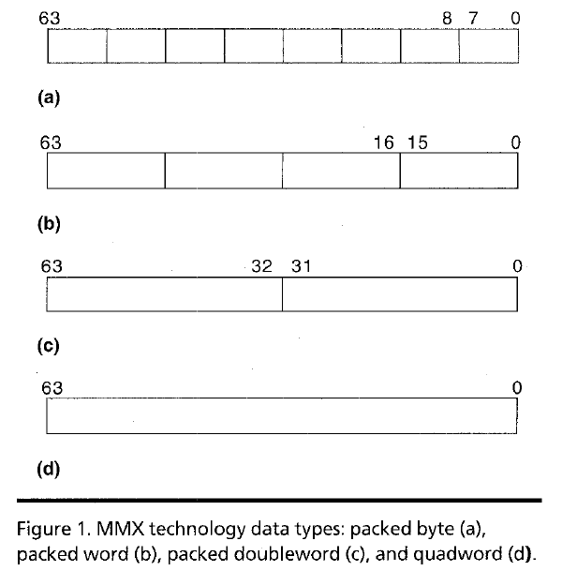
Intel Pentium MMX Operations
Idea: One instruction operates on multiple data elements simultaneously
À la array processing (yet much more limited)
Designed with multimedia (graphics) operations in mind
No VLEN register
Opcode determines data type:
8 8-bit bytes
4 16-bit words
2 32-bit doublewords
1 64-bit quadword
Stride is always equal to 1.
Peleg and Weiser, “MMX Technology
Extension to the Intel Architecture,”
IEEE Micro, 1996.
Notes:
the idea is to operate on multimedia graphics workloads in a way that we can take advantage of the existing values by operating on multiple data elements at the same time, and multiple data elements might be eight bytes or four 16-bit words, or two 32-bit double words or one 64-bit quad world

Slide 6
Heterogeneous Computing Systems
The end of Moore’s law created the need for heterogeneous systems
More suitable devices for each type of workload
Increased performance and energy efficiency
CPU core 0
CPU core 1
…
CPU core N-1
CU
CU
CU
…
CU
CU
FPGA
GPU
L1
L1
…
L1
L1
L1
L1
…
L1
L1
Scratchpad
DMA
L2
L2
Coherent interconnect
LLC
Crossbar
DRAM controller
DRAM
DRAM
DRAM
DRAM
Non-coherent bus
Coherent bus
Chang+, “Collaborative Computing for Heterogeneous Integrated Systems,” ICPE 2017.
Notes:
The type of computation that we can have in heterogeneous systems. it's more and more frequent that we have seen not only the extensions but also many more complex heterogeneous devices in the same system in the same package or even in the same chip, and these devices can be CPU cores with their cache hierarchy they can be GPU cores or they can be reconfigurable fabric like FPGAs or also other types of accelerators. For example, all these processors all these devices have access to some external memory typically dram through a DRAM controller, and they also can also share data using the shared levels of cache in some cases, we also find coherent interconnects to make sure that all these processors here always access updated values of the variables we are going to introduce these coherent also interconnects.

Slide 7
P&S Heterogeneous Systems: Contents
We will introduce the need for heterogeneity in current computing systems, in order to achieve high performance and energy efficiency
You will get familiar with some of the different heterogeneous devices that are available in computing systems
You will learn workload distribution and parallelization strategies that leverage heterogeneous devices
You will work hands-on: analyzing workloads, programming heterogeneous architectures, proposing scheduling/offloading mechanisms, etc.
Notes:
you will be introduced to the need for their unity income and current computing systems in order to achieve high performance and energy efficiency. you will get familiar with some of the different routines and devices that are available in computing systems. you will learn workload distribution and parallelization and strategies that leverage heterogeneous systems and you will work hands-on analyzing workloads programming heterogeneous architectures proposing scheduling and loading mechanisms etc.

Slide 8
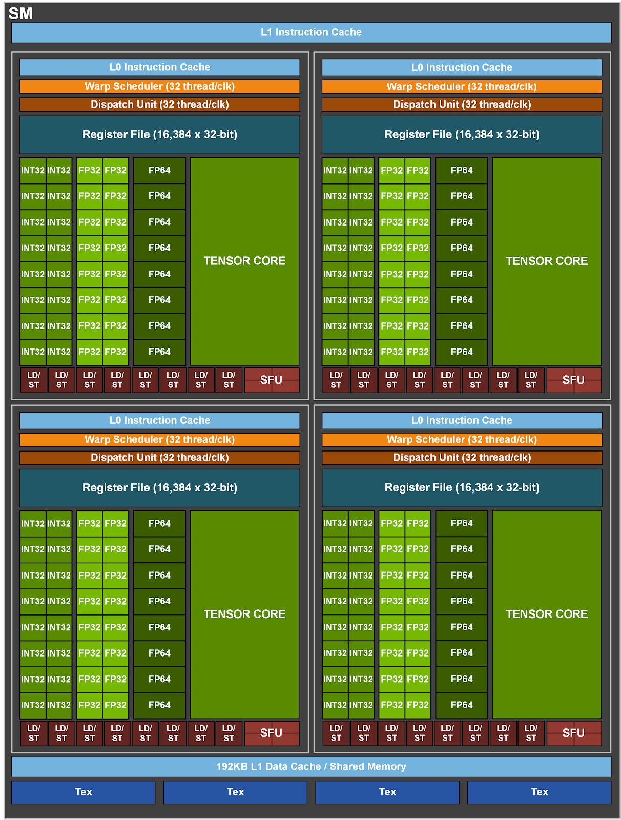
NVIDIA A100 Core
GPU compute throughput:
19.5 TFLOPS Single Precision
9.7 TFLOPS Double Precision
312 TFLOPS for Deep Learning (Tensor cores)
https://developer.nvidia.com/blog/nvidia-ampere-architecture-in-depth/
Notes:
A100 fine-grained structured sparsity prunes trained weights with a 2-out-of-4 non-zero pattern, followed by a simple and universal recipe for fine-tuning the non-zero weights. The weights are compressed for a 2x reduction in data footprint and bandwidth, and the A100 Sparse Tensor Core doubles math throughput by skipping the zeros (see https://developer.nvidia.com/blog/nvidia-ampere-architecture-in-depth/).
we can see in the image one GPU core or a streaming multiprocessor or Nvidia and if you check the different blocks that compose a 100 core. you will see that it's also heterogeneous by itself. it has integer 32 units and has integer 32-bit floating point units and 64-bit floating-point units and also other specialized processing elements that are called tensor cores that are specialized for deep learning.

Slide 9
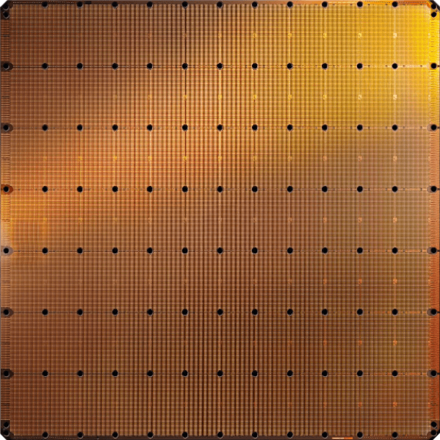
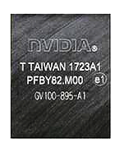
Cerebras’s Wafer Scale Engine-2 (2021)
The largest ML
accelerator chip (2021)
850,000 cores
Cerebras WSE-2
2.6 Trillion transistors
46,225 mm²
Largest GPU
54.2 Billion transistors
826 mm²
NVIDIA Ampere GA100
https://www.anandtech.com/show/14758/hot-chips-31-live-blogs-cerebras-wafer-scale-deep-learning
https://www.cerebras.net/cerebras-wafer-scale-engine-why-we-need-big-chips-for-deep-learning/
Notes:
for deep learning, we have seen appear many new devices and accelerators due to the importance of machine learning and artificial intelligence. a good example is this Cerebras wafer scale engine from 2019 which is the largest ml accelerator chip, actually is not even achieved an entire wafer composed of multiple tiles with memory and processing elements to be super fast and super energy efficient for machine learning workloads, and more recently in 2021 servers released the new version of the wafer scale engine 2.

Slide 10
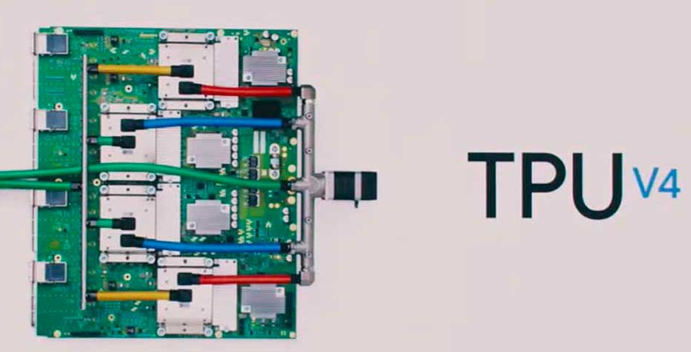
Google TPU Generation IV (2019)
250 TFLOPS per chip in 2021
vs 90 TFLOPS in TPU3
New ML applications (vs. TPU3):
Computer vision
Natural Language Processing (NLP)
Recommender system
Reinforcement learning that plays Go
1 ExaFLOPS per board
https://spectrum.ieee.org/tech-talk/computing/hardware/heres-how-googles-tpu-v4-ai-chip-stacked-up-in-training-tests
Notes:
For an image classification task, 256 Google TPUv4’s performance is nearly as fast as 768 Nvidia A100 graphics cards combined with 192 AMD Epyc 7742 CPU cores and 512 of Huawei’s AI-optimized Ascend910 chips paired with 128 Intel Xeon Platinum 8168 cores.
https://venturebeat.com/2021/05/18/google-details-new-ai-accelerator-chips/

Slide 11
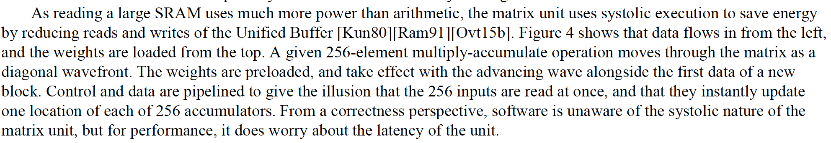
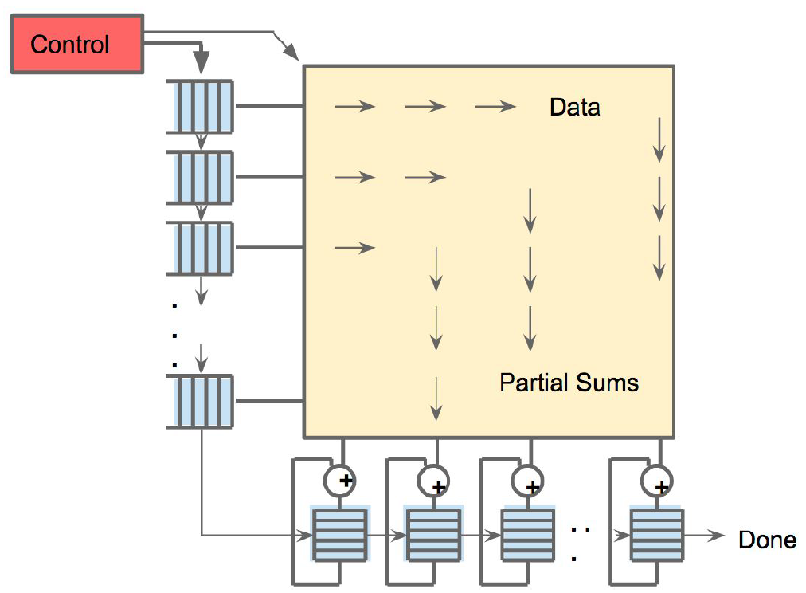
An Example Modern Systolic Array: TPU (II)
Jouppi et al., “In-Datacenter Performance Analysis of a Tensor Processing Unit”, ISCA 2017.
Notes:
since 2016 google has tpu tensor processing unit and we have already seen four successive generations of this google tpu, the second generation was released in 2017, 2019 the third generation, and in 2019 also the fourth generation. And each of these generations has been more and more powerful and has more memory as well but in the end, all of them are conceptually the same they are a modern systolic array.

Slide 12
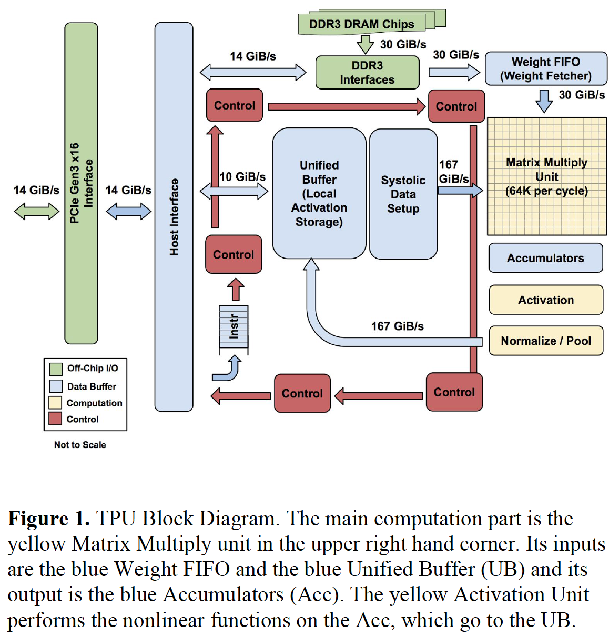
An Example Modern Systolic Array: TPU (III)
Notes:
this TPU with this matrix multiplies units on the right-hand side. that is a systolic array that performs matrix multiplication efficiently by combining values coming from FIFO of weights and also the input data input feature maps coming from other buffers. and also you can see the rest of the components with interfaces to access external DRAM and also be accessed from the halls using our PCI express bus.

Slide 13
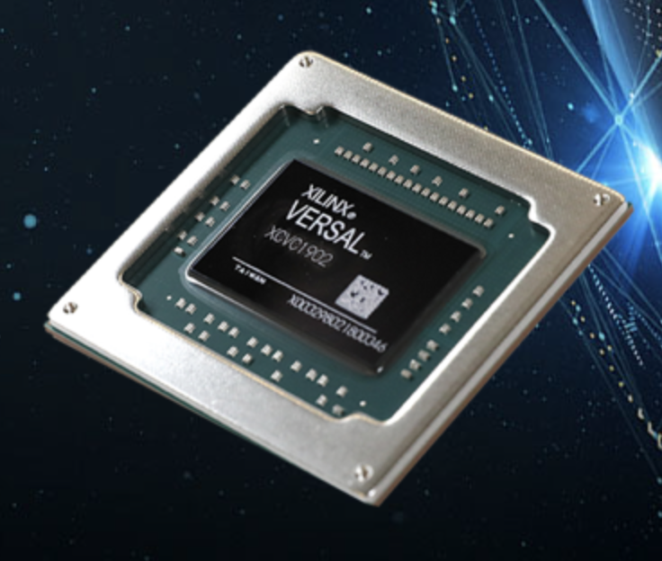
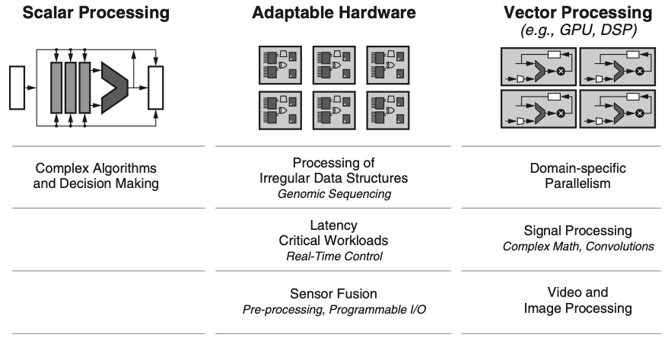
Xilinx Versal ACAP (2020) (I)
Three compute engines inside the same chip
Different workloads, different devices
https://www.xilinx.com/products/silicon-devices/acap/versal.html
Notes:
from 2020 which has different types of devices inside the same chip. the internals of Versal you will see there are some scalar engines like for example arm dual core. there are two types of cores. there are also adaptable engines that are completely configurable and can also be used to create a custom memory hierarchy this part is more similar to reconfigurable fabric or an FPGA.

Slide 14
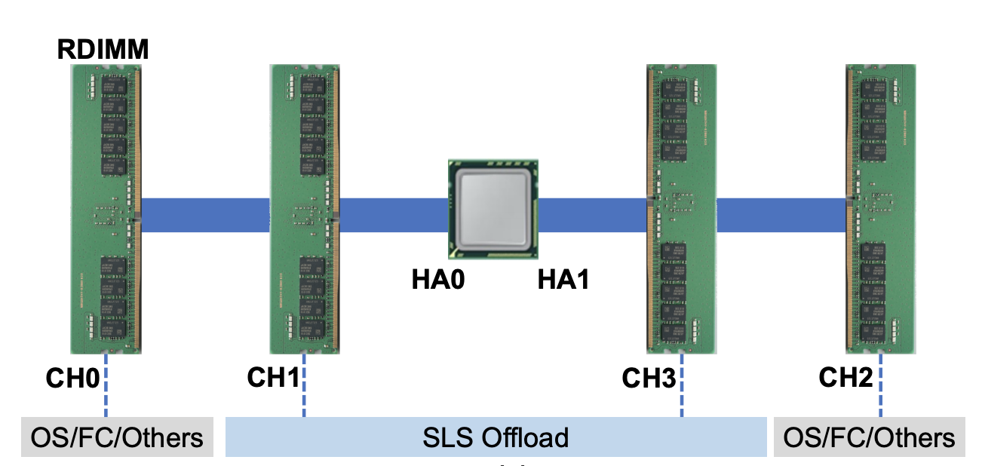
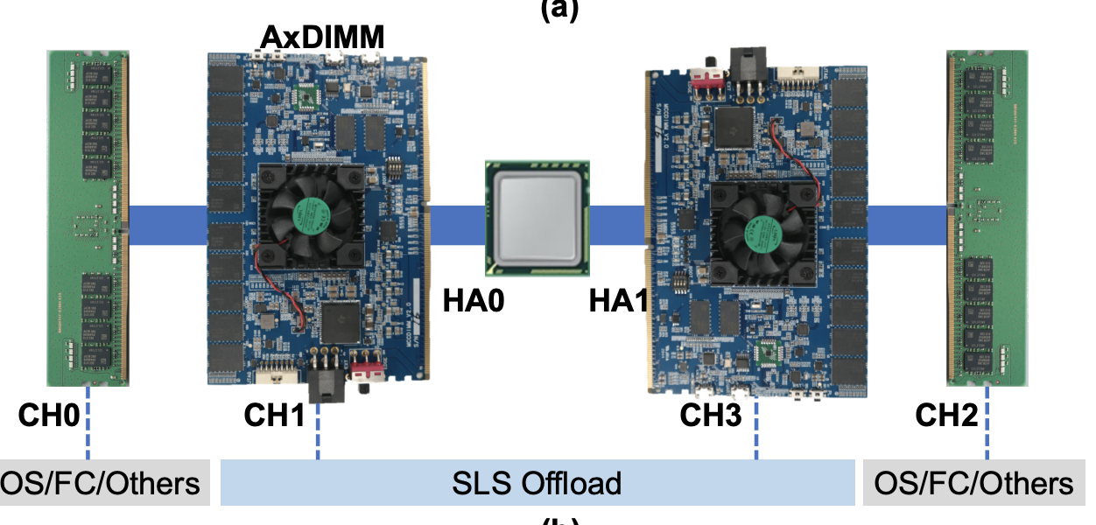
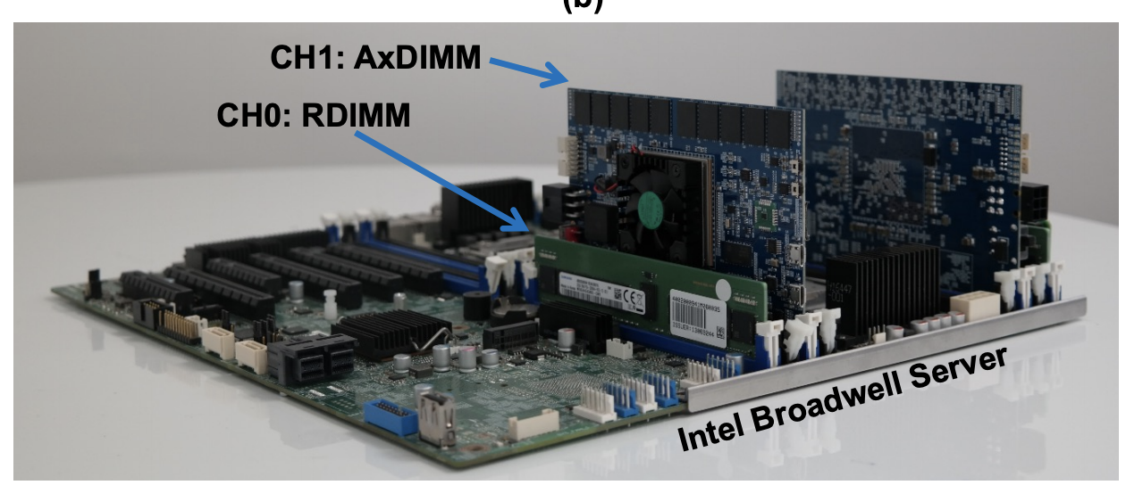
Samsung AxDIMM (2021)
DIMM-based PIM
DLRM recommendation system
Baseline System
AxDIMM System
Ke et al. "Near-Memory Processing in Action: Accelerating Personalized Recommendation with AxDIMM", IEEE Micro (2021)
Notes:
another example of processing in-memory architecture is the Samsung AxDIMM-based PIM. we can play some sort of processing capabilities in this case. they demonstrated this system by including an FPGA on the beam and configuring or customizing this FPGA for our recommendation system and they show results about this AxDIMM-based PIM.

Slide 15
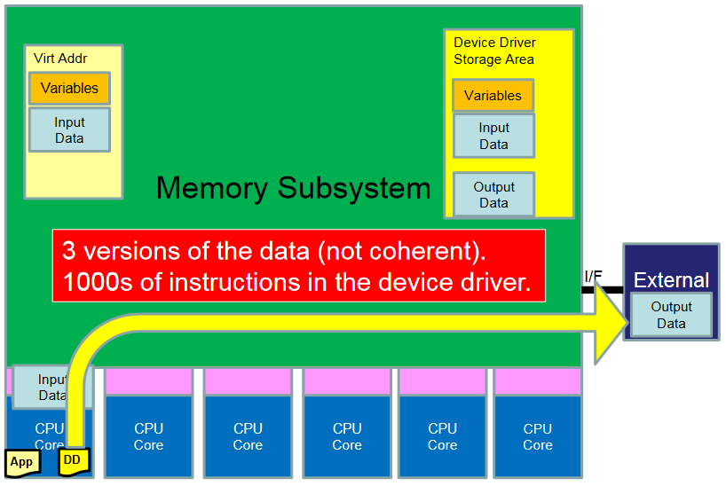
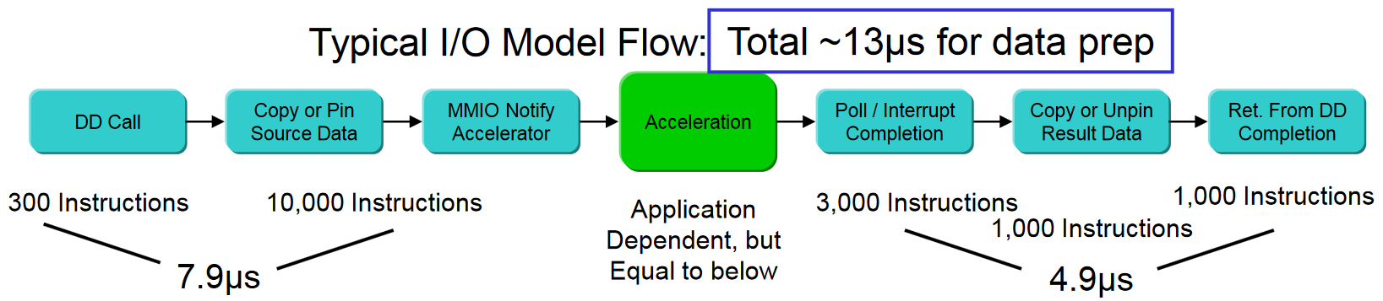

Background: Traditional I/O Technology
Dionysios Diamantopoulos, IBM Research – Zurich, COOL Chips 2018
Notes:
CAPI2 eliminates data copies of host-based PCI-express stack by providing an interface to the accelerator to directly access the copy in host memory.
We have many different accelerators and many different types of general-purpose processors or CPUs and GPUs in the system. but now connecting is not easy to enable ways of connecting the different heterogeneous devices in a way that is seamless, a high throughput, and low latency. because traditionally what we have to do is moving the data in chunks from the CPU memory from the main memory to the memory of the accelerator, and after that start the computation on the accelerator side all this communication was the responsibility of the programmer. that needs to decide when to move something in order for the different ethernet devices to have access to the most recent values of each variable.

Slide 16
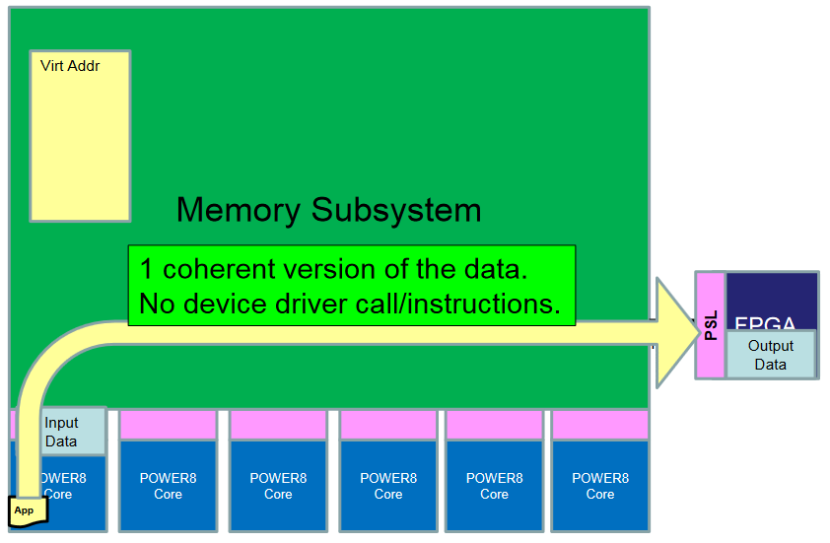
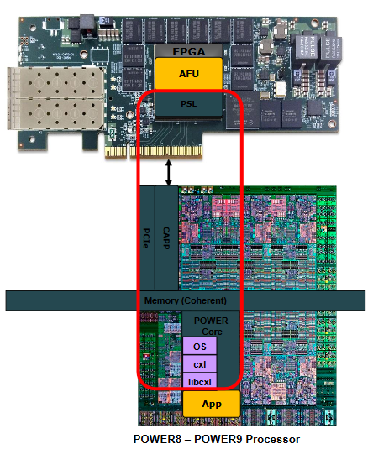
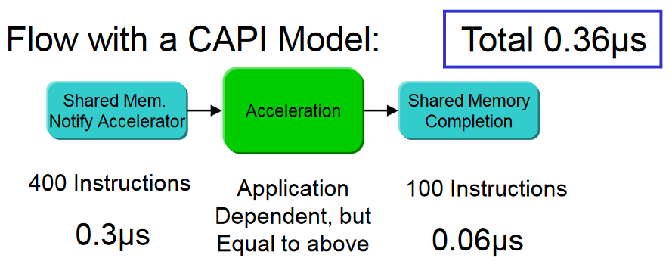
CAPI/OpenCAPI Overview
CAPI/CAPI2 (Coherent Accelerator Processor Interface)
OpenCAPI
Dionysios Diamantopoulos, IBM Research – Zurich, COOL Chips 2018
Notes:
CAPI2 eliminates data copies of host-based PCI-express stack by providing an interface to the accelerator to directly access the copy in host memory.
The coherent accelerator processor interface CAPI is one of these examples. OpenCAPI is a larger consortium that was started by ibm and this coherent accelerator processor interface allows the seamless integration of an accelerator into a cpu system and the cpu have direct access to the memory of the FPGA.

Slide 17
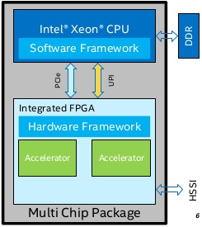
Collaborative Computing on CPU+FPGA
Traditionally, accelerators (GPUs, FPGAs, etc.) have been used as offload engines
Heterogeneous architectures moving towards tighter integration
Unified memory
System-wide atomics
Tighter integration allows fine-grained collaboration
HSSI
Key challenge: identify the best CPU-FPGA collaboration strategy
Intel Xeon + FPGA Integrated Platform (MCP)
Huang+, "Analysis and Modeling of Collaborative Execution Strategies for Heterogeneous CPU-FPGA Architectures," ICPE 2019
Notes:
Another example is the Intel Xeon + FPGA integrated platform, where CPU and FPGA are connected via Intel UPI interconnect and PCIe.
(click)
The trend towards tighter integration of CPUs and FPGAs enables more collaborative execution between devices. Rather than executing an entire kernel on the FPGA while the CPU is idle, collaborative execution makes better use of the overall system resources by involving both CPU threads and FPGA in the execution.
(click)
One of the key challenges of collaborative execution between CPUs and FPGAs is the identification of the best strategy for partitioning work between the CPU and the FPGA. There are two major approaches to partitioning of work, data partitioning and task partitioning. We will present both partitioning schemes in the following slides.
we have also seen similar ideas in intel devices as well for example intel chip that integrates an intel xeon processor and an fpga in the the same package and also they have fine grain. they are designed for fine-grained collaboration between the cpu side and the fpga side.

Slide 18
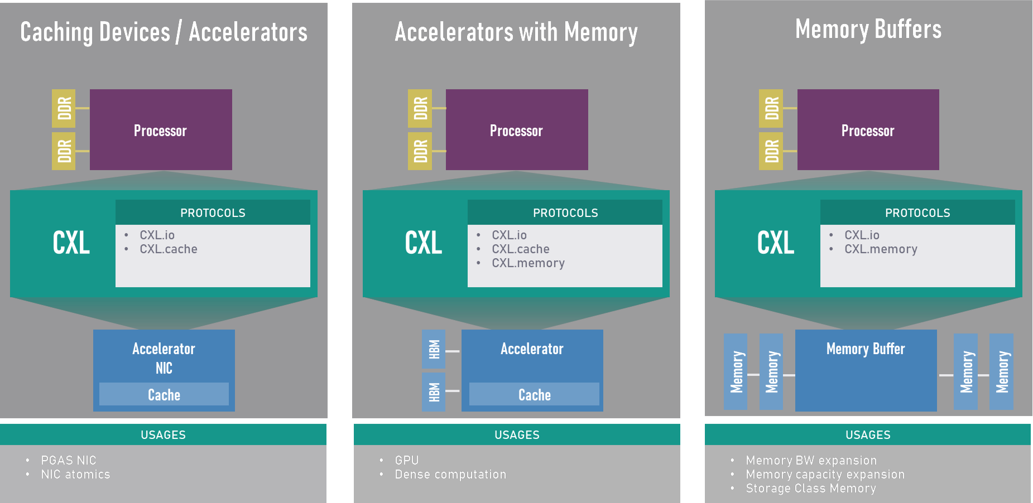
Compute Express Link (CXL)
Compute Express Link (CXL) is an open industry standard interconnect offering high-bandwidth, low-latency connectivity between host processor and devices such as accelerators, memory buffers, and smart I/O devices
https://www.computeexpresslink.org/_files/ugd/0c1418_14c5283e7f3e40f9b2955c7d0f60bebe.pdf
Notes:
another example is compute express link and other open industry standard interconnect offering high bandwidth low latency connectivity between the host processor and the devices. it says different ways of being used with accelerators, with accelerators, with their own memory and with memory buffers.

Slide 19
Key Takeaways
This course is aimed at improving your
Knowledge in Computer Architecture and Heterogeneous Systems
Technical skills in programming heterogeneous architectures
Critical thinking and analysis
Familiarity with key research directions
Notes:
key takeaways of this course and and after finish this course is aimed at improving your knowledge in computer architecture and heterogeneous systems, technical skills in programming intelligence architectures, critical thinking and analysis.

Slide 20
Key Goal
(Learn how to) take advantage of existing heterogeneous devices
by programming them,
analyzing workloads, proposing offloading/scheduling techniques…
Notes:
the key goal of the course is to learn how to take advantage of existing heterogeneous devices by programming them, analyzing workloads, proposing of loading scheduling techniques etc

Slide 21
Prerequisites of the Course
Digital Design and Computer Architecture (or equivalent course)
Familiarity with C/C++ programming
FPGA implementation or GPU programming (desirable)
Interest in
computer architectures and computing paradigms
discovering why things do or do not work and solving problems
making systems efficient and usable
Notes:
it's important to have a relatively good background in digital design and computer architecture. it's necessary for this course to have familiarity with c and C++ programming and if you also have familiarity with FPGA implementation or GPU programming. and what we expect from you is that you have an interest in computer architectures, and computing paradigms discovering why things work or do not work, and solve problems, and making systems efficient and usable.

Slide 22
Exploiting Data Parallelism: SIMD Processors and GPUs

Slide 23
Recall: Flynn’s Taxonomy of Computers
Mike Flynn, “Very High-Speed Computing Systems,” Proc. of IEEE, 1966
SISD: Single instruction operates on single data element
SIMD: Single instruction operates on multiple data elements
Array processor
Vector processor
MISD: Multiple instructions operate on single data element
Closest form: systolic array processor, streaming processor
MIMD: Multiple instructions operate on multiple data elements (multiple instruction streams)
Multiprocessor
Multithreaded processor
Notes:
We start focusing on SIMD processors that are those that allow us to execute to operate on multiple data elements using a single instruction

Slide 24
SIMD Processing
Single instruction operates on multiple data elements
In time or in space
Multiple processing elements (PEs), i.e., execution units
Time-space duality
Array processor: Instruction operates on multiple data elements at the same time using different spaces (PEs)
Vector processor: Instruction operates on multiple data elements in consecutive time steps using the same space (PE)
Notes:
SIMD processors in summary operate with a single instruction on multiple data elements at a time or in the same space because of this duality that we have in time of our space. we call the time-space duality that allows us to distinguish between array processors. that are processors where one instruction operates on multiple data elements at the same time using different spaces or different processing elements, and vector processors where an instruction operates on multiple data elements in consecutive time steps using the same space and the same processing element.

Slide 25
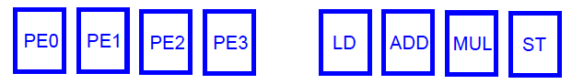
Array vs. Vector Processors
ARRAY PROCESSOR
VECTOR PROCESSOR
Instruction Stream
Same op @ same time
LD VR ← A[3:0]
ADD VR ← VR, 1
MUL VR ← VR, 2
ST A[3:0] ← VR
Different ops @ time
LD0
LD1
LD2
LD3
LD0
AD0
AD1
AD2
AD3
LD1
AD0
MU0
MU1
MU2
MU3
LD2
AD1
MU0
ST0
ST1
ST2
ST3
LD3
AD2
MU1
ST0
Different ops @ same space
AD3
MU2
ST1
MU3
ST2
Time
Same op @ space
ST3
Space
Space
Notes:
our first SIMD code with a load instruction and addition multiplication and a store operation here. what we are doing is using vector registers that are these registers containing multiple elements that are going to be operated on by the same instruction. and the first thing that we do is loading data from memory from this array a into the vector register. then we add one to the vector register. then we multiply to the contents the individual elements in this vector element we multiply them by two. and finally we store the results in the corresponding location in memory. in the case of the array processor we have multiple processing elements all of them are exactly the same and all of them are able to execute different types of instructions. and this way in the first cycle we issue the vector, load this vector, load instruction that is going to be mapped and is going to be executed on these four processing elements at the same time for the four elements that the vector register contains. in the next cycle we issue the addition, then the multiplication, and then the store operation. we have the same operation at the same time on different spaces on different processing elements but we have different operations in the same space at different times. so this is the time from top to bottom and space from left to right in a vector processor. we have different processing elements each of them are specialized so if we want to execute our vector load for example. we will have to issue one load of one element every cycle and in the addition unit we can do the same for the addition instruction. we will execute the addition first for element zero in the vector register. then for element one in the vector register and so on. we have different operations at the time in this particular cycle. we have a load and add a move and store in the four different processing elements of different operations at the same time. and we have the same operation in the same space because these processing elements are specialized. and even though this classification and this distinction of array and vector processors might look like simple and kind of obvious. this is the way we keep building SIMD processors.

Slide 26
NVIDIA A100 Core
GPU compute throughput:
19.5 TFLOPS Single Precision
9.7 TFLOPS Double Precision
312 TFLOPS for Deep Learning (Tensor cores)
https://developer.nvidia.com/blog/nvidia-ampere-architecture-in-depth/
Notes:
A100 fine-grained structured sparsity prunes trained weights with a 2-out-of-4 non-zero pattern, followed by a simple and universal recipe for fine-tuning the non-zero weights. The weights are compressed for a 2x reduction in data footprint and bandwidth, and the A100 Sparse Tensor Core doubles math throughput by skipping the zeros (see https://developer.nvidia.com/blog/nvidia-ampere-architecture-in-depth/).
according to this a 100 GPU, we have different types of processing elements like this a 32-bit integer, 32-bit floating point, 64-bit floating point, etc but also we have multiple of these so that means that we can operate on multiple 32-bit elements at a time or 32-bit floating-point elements at a time and so on. so a GPU, in the end, combines some characteristics from the vector processor and characteristics from the processor. and it's not the only computing paradigm that incorporates the GPUs incorporate into its architecture of fine-grained multi-threading. so these are relatively complex systems with a lot of potentials in terms of energy consumption and also in terms of energy efficiency and performance.

Slide 27
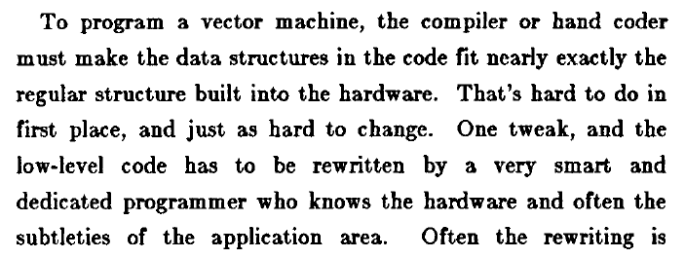
Vector Processor Disadvantages
-- Works (only) if parallelism is regular (data/SIMD parallelism)
++ Vector operations
-- Very inefficient if parallelism is irregular
-- How about searching for a key in a linked list?
Fisher, “Very Long Instruction Word architectures and the ELI-512,” ISCA 1983.
Notes:
they also have disadvantages and that was already pointed out by Fisher many years ago in 1983. in this paper where he says to program a vector machine, the compiler or hand-holder must make the data structures in the code fit nearly exactly the regular structure built into the hardware. We will see that the structure of these devices of these processors is very regular, but the data structures that we may need to use for algorithms or applications may not be so regular, and mapping perfectly. the data structure onto the hardware is something really challenging. as fisher said that's hard to do in the first place and just as hard to change. so one of the key challenges and weaknesses of vector processors and simply processors and GPUs is the difficulty of programming them in an efficient manner.

Slide 28
Warps not Exposed to GPU Programmers
CPU threads and GPU kernels
Sequential or modestly parallel sections on CPU
Massively parallel sections on GPU: Blocks of threads
Serial Code (host)
Parallel Kernel (device)
KernelA<<<nBlk, nThr>>>(args);
. . .
Serial Code (host)
Parallel Kernel (device)
KernelB<<<nBlk, nThr>>>(args);
. . .
Slide credit: Hwu & Kirk
Notes:
we are going to have a heterogeneous application running on it and that means that we are going to keep using the GPU, but also CPU threads that run on a CPU in a way that serial or modestly parallel sections of the code, or the application will keep running, or continue running on the CPU while massively parallel sections of code will run on the GPU and will run using blocks of threads. we will have some serial code or modestly parallel code running on the CPU, then at some point, we will reach a parallel section where we can operate on multiple data elements at the same time, and we will launch the GPU function the function that runs on the GPU called parallel kernel or simply kernel. we define the number of threads that we are going to use on the GPU. and we cluster group these threads into blocks in a similar way when one kernel terminates the controller returns to the CPU. some more serial code is executed on the CPU and at some point, a new kernel may be launched for execution on the GPU.

Slide 29
Sample GPU SIMT Code (Simplified)
CPU code
for (ii = 0; ii < 100000; ++ii) {
C[ii] = A[ii] + B[ii];
}
CUDA code
// there are 100000 threads
__global__ void KernelFunction(…) {
int tid = blockDim.x * blockIdx.x + threadIdx.x;
int varA = aa[tid];
int varB = bb[tid];
C[tid] = varA + varB;
}
Notes:
we are going to work with the cuda framework mostly. this is just a vector addition and you would implement it using c code on a CPU and implement it using cuda code notice that we call global the kernel function that executes on the GPU. in this kernel we see that it's essentially memory access and addition and finally a store in the output array. we see the key difference between cuda code and the CPU code. in the CPU code, we are simply using an index i. while in the GPU we are using a thread index after an index that identifies each of the different threads that we are using in our program and based on this thread index we access different elements in memory and operate on them.

Slide 30
Vector Processor Disadvantages
-- Works (only) if parallelism is regular (data/SIMD parallelism)
++ Vector operations
-- Very inefficient if parallelism is irregular
-- How about searching for a key in a linked list?
Fisher, “Very Long Instruction Word architectures and the ELI-512,” ISCA 1983.

Slide 31
Heterogeneous Computing Systems
The end of Moore’s law created the need for heterogeneous systems
More suitable devices for each type of workload
Increased performance and energy efficiency
CPU core 0
CPU core 1
…
CPU core N-1
CU
CU
CU
…
CU
CU
FPGA
GPU
L1
L1
…
L1
L1
L1
L1
…
L1
L1
Scratchpad
DMA
L2
L2
Coherent interconnect
LLC
Crossbar
DRAM controller
DRAM
DRAM
DRAM
DRAM
Non-coherent bus
Coherent bus
Chang+, “Collaborative Computing for Heterogeneous Integrated Systems,” ICPE 2017.

